Slide 1
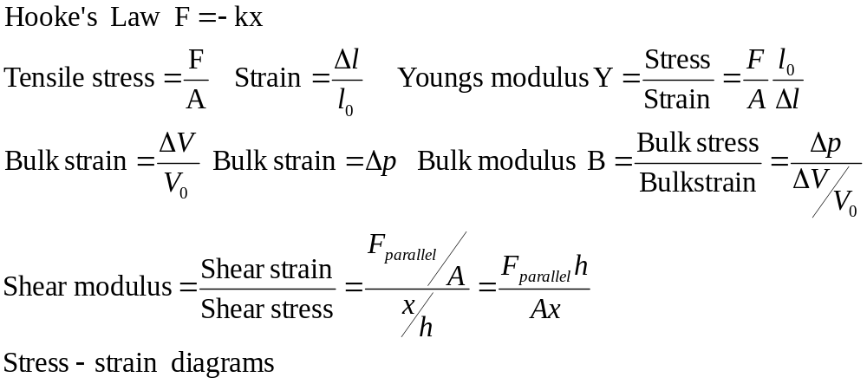

Elasticity
Physics 131
Lecture 17
All found in Young and Freedman, University Physics, chapter 11, sections 4 and 5
Notes:
Demo- Bike wheel
Syringe compressing water and air
Wire- youngs modulus
with is what’s termed elasticity, what is it and how does Hooke’s law fit in, and then move onto some specific cases where forces are applied in certain specific ways. Then we’ll study what happens to a material when it is stretched by understanding the graph showing basically applied force vs elongation. We’ll do a few example problems to show how to tackle them.
Here’s a list of what you need to know from this lecture. You have this information on the handout I have given you. The handout also includes the text book references.

Slide 2
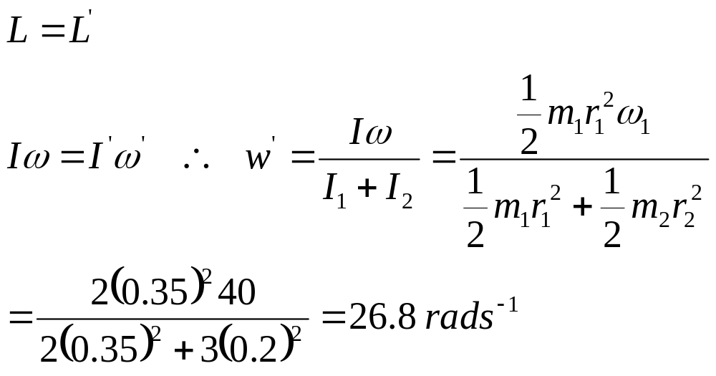
Review: Conservation of Angular Momentum
A 2kg solid disc of radius 35 cm, is spinning at 40 rad/s. A 3kg solid disc of radius 20 cm with the same centre of axis and at rest, is dropped down from above. What is the new rotational velocity of the pair.
Notes:
Last lecture we looked at angular momentum…talk through it

Slide 3
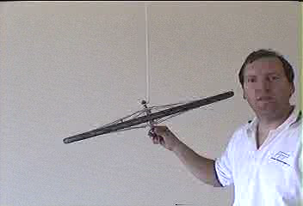
Gyroscopes

Slide 4
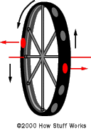
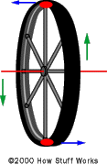
Gyroscopes

Slide 5
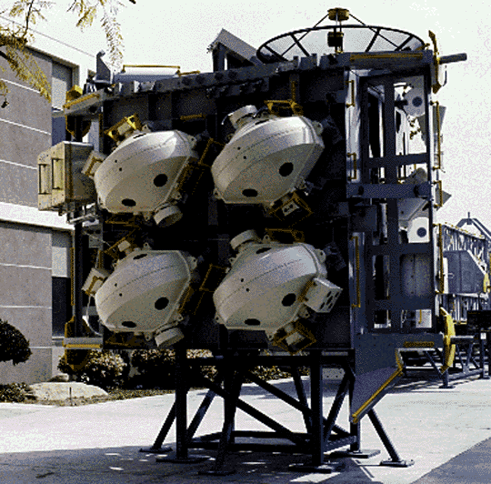
Gyroscopes in ISS

Slide 6

Ship stabilizer

Slide 7
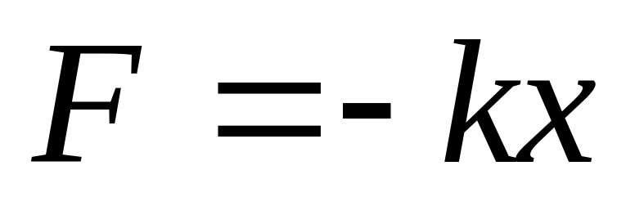
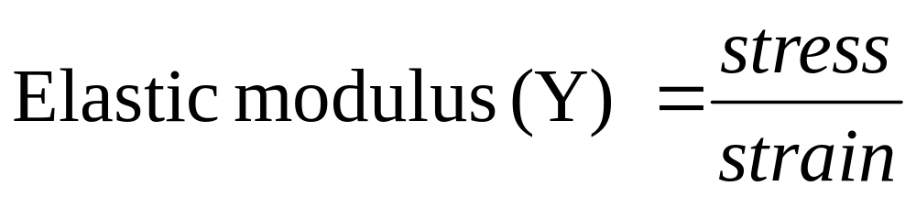
Hooke’s Law and elasticity
Known as Hooke’s law
Where stress is a measure of the applied force and strain is a measure of the deformation due to the force.
Notes:
What happens to an object when a force is applied to it. The basic concept we’ll study is called elasticity and its generic form is as shown (elastic modulus = stress/strain). Ie these two quantities, stress and strain are proportional to one another (stress is proportional to strain hence stress = something times strain, stress = elastic modulus times strain….hence elastic modulus = stress/strain).
Where stress is a measure of the applied force and strain is a measure of the deformation due to the force. So we see that the deformation is related to the force applied.

Slide 8
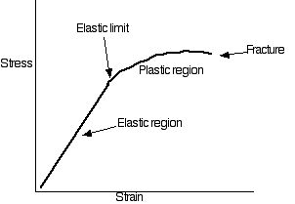
Stress-Strain diagrams for brittle substances (eg bone)
Notes:
Here’s a Stress strain diagram for bone….see that fracture occurs just after the elastic limit is reached. So when bone is stretched it remains elastic unless the force/area is so great that it breaks. ie if apply a force then take force off it reverts to its original shape unless it is broken which happens when the stress is greater than the breaking stress. No plastic deformation after the elastic limit reached as it breaks at the elastic limit. Such materials are termed brittle. The slope of the curve up to the elastic limit has the value Y, Young’s modulus.

Slide 9
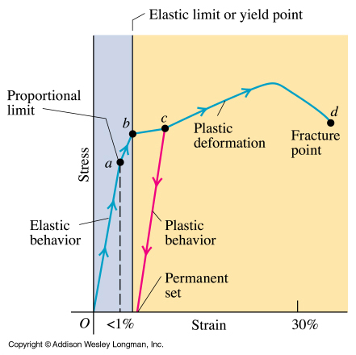
Stress-Strain diagrams for ductile substances (eg copper)
Notes:
So now we understand stress, strain and their relationship. We’ve said that at low stress the two are proportional, stress is proportional to strain and in fact stress/strain = Young’s modulus. This is known as Hooke’s law.
Here we have a diagram showing how stress changes as strain changes, or how changes in the force applied per unit area lead to changes in the amount of deformation. This is called a Stress strain diagram and this one is for a metal under tension (ie being pulled).
You can see that the proportionality law is not obeyed for all stresses and strains….only up to a certain value of stress. This is known as the proportional limit. (POINT OUT point a). From O to a got stress/strain = Y.
Although from a to b the proportional law is not obeyed we still find that the material will return to its original length once the force or load is taken away. So from O to b we have elastic behaviour occuring, the material will be stretched as stress increases but it returns to its original size when the stress is removed. Point b is called the yield point and the stress at this point is called the elastic limit (POINT OUT).
When we increase the stress beyond b the strain continues to increase, but when the load is removed the material doesn’t return to its original length. (SEE RED LINE). This is known as plastic deformation. Further increase of load beyond this point produces a large increase in strain for a relatively small increase in stress, until point d is reached where fracture occurs. For some materials (like copper) a large amount of plastic deformation occurs between elastic limit and fracture point – called ductile.
The stress required to cause fracture is called the breaking stress or tensile strength. If the object is being compressed rather than stretched this point is called the compressive strength. Both these values are a measure of the maximum value of force/unit area (pushing or pulling) that can be applied before the object will break.

Slide 10

Horizontal Bungee

Slide 11
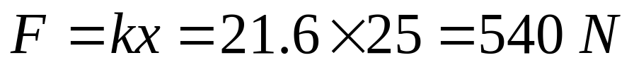
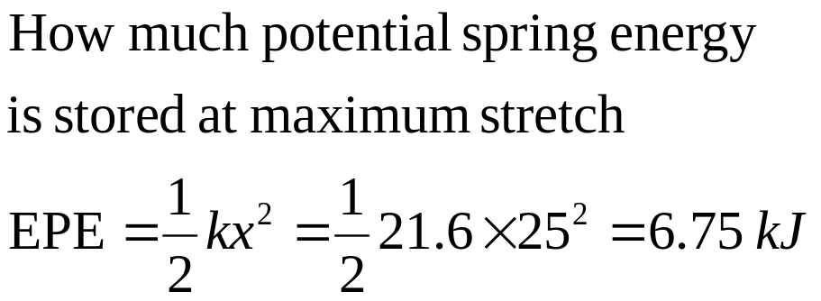
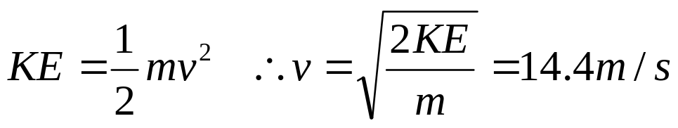
Debbie Bungee jumping
If the bungee rope has a spring constant k=10.8 Nm⁻¹. Debbie weighs 65 kg. Doubling it will double the spring constant for the setup. k’=21.6Nm⁻¹.
The quadbike drives 25 m before releasing the catch.
Calculate the force on Debbie at maximum stretch
Find the potential energy of the elastic rope at full stretch x = 25 m
Calculate the velocity of Debbie at x=0, as she returns to original position

Slide 12
Elasticity
Elasticity is the property of materials which tends to return a body to its original shape after the force is removed. When a small force is applied and removed, a body often reverts to its original shape, and a process is said to be elastic. For larger forces, the original shape may not be restored, and the process is said to be inelastic. Very large forces may fracture the object.
Compressive or tensile strength= breaking stress or strain- refers to the maximum stress or strain that can be exerted on the material before, complete fracture/breakage. The material may undergo plastic deformation before fracture occurs.
Notes:
What do we mean by elastic case ? Well elasticity is the property of materials which tends to return a body to its original shape after the force is removed. When a small force is applied and removed, a body often reverts to its original shape, and a process is said to be elastic. For larger forces, the original shape may not be restored, and the process is said to be inelastic. Very large forces may fracture the object.
So when we’re talking of studying situations where they are elastic it means that a small force is being applied such that the body reverts to its original shape once the force is removed.

Slide 13

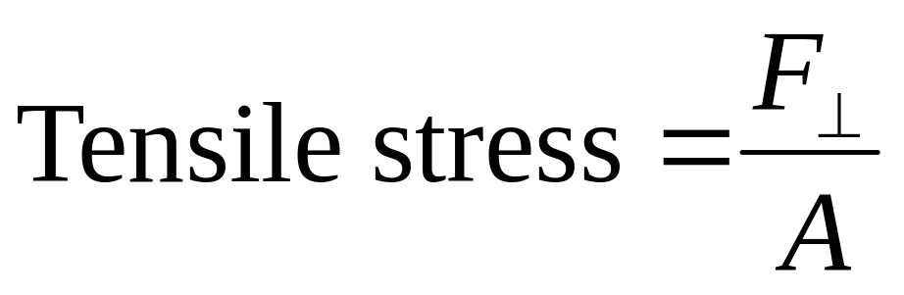
So what does stress mean?
Stress is the strength of the forces causing the deformation, on a “force per unit area” basis.
For example tensile stress on a piece of wire is the force exerted on the wire divided by the cross sectional area.

Slide 14
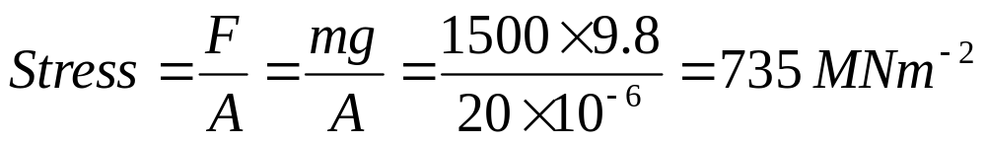
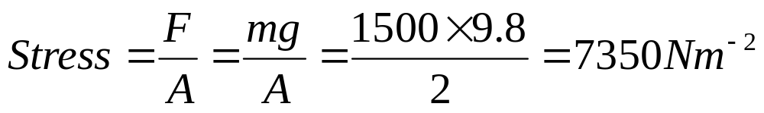
Example: Stress
Find the stress on a wire cable of cross sectional area 20mm², holding a 1500 kg car above the ground
Increase the cross sectional area of the wire cable to 2m². What is the stress in it now?

Slide 15
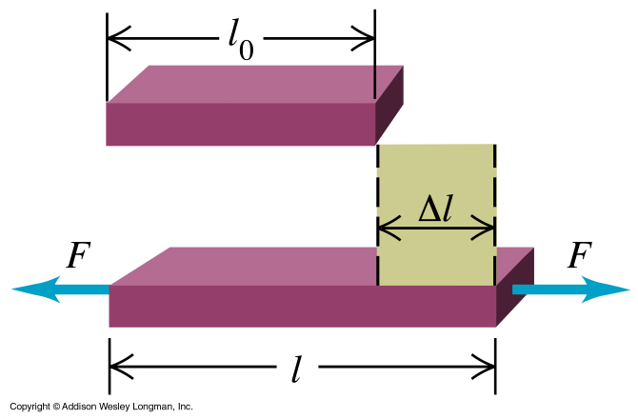

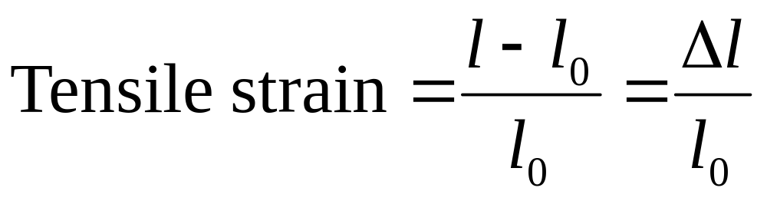
What is Strain?
Strain describes the resulting deformation.
For example tensile strain on a piece of wire is the extension of the wire Δl divided by the original length l₀.

Slide 16


Strain=Δl/l₀ is usually similar in tension and compression
Notes:
Always have to be sensible – it’s a bit hard to compress 1 meter of wire- wire will bend….
Though usually the extension produced by a force is the same for a compressive force.

Slide 17
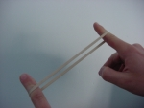
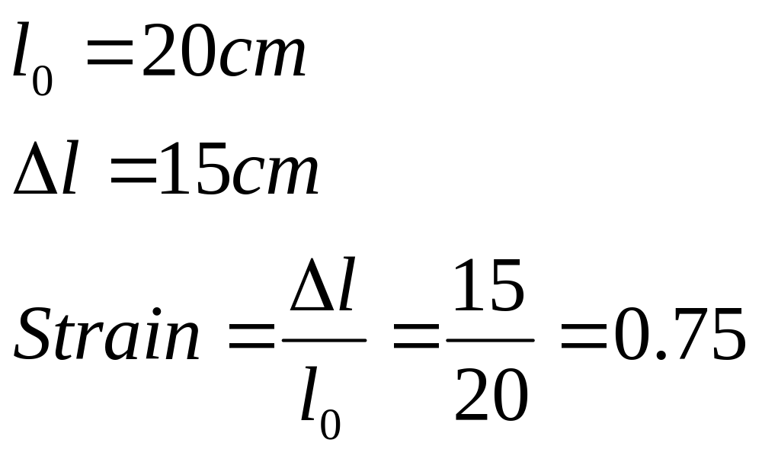
Example: Strain of elastic band
Calculate the strain in an elastic band. It was originally 20 cm long and it’s final length was 35 cm long.

Slide 18
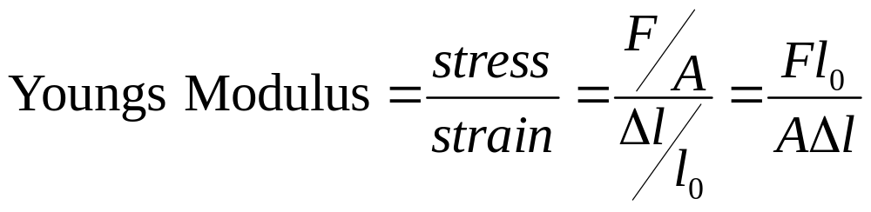
Tensile stress and strain
Unit for Y = Pascal (Pa)
Notes:
Experiment has shown that for small stress ie small force per unit area, stress and strain are proportional as we saw in that first equation. (stress /strain = elastic modulus). In this case the elastic modulus is called Young’s modulus, denoted as Y. The units are force per unit area, known as Pascals. The value for cast steel is 2 times 10 to the 11 Pa. For rubber 5 times 10 to the 8 Pa. High values of Y mean relatively unstretchable..a big force needed to produce an extension.

Slide 19
Elastic constants for various materials
Material | Young’s modulus (N/m²) | Tensile strength (N/m²) | Compressive strength (N/m²)
Steel | 200 x 10⁹ | 500 x 10⁶ | 500 x 10⁶
Copper | 100 x 10⁹ | 250 x 10⁶ | 250 x 10⁶
Concrete | 20 x 10⁹ | 2 x 10⁶ | 20 x 10⁶
Bone | 15 x 10⁹ | 130 x 10⁶ | 170 x 10⁶

Slide 20
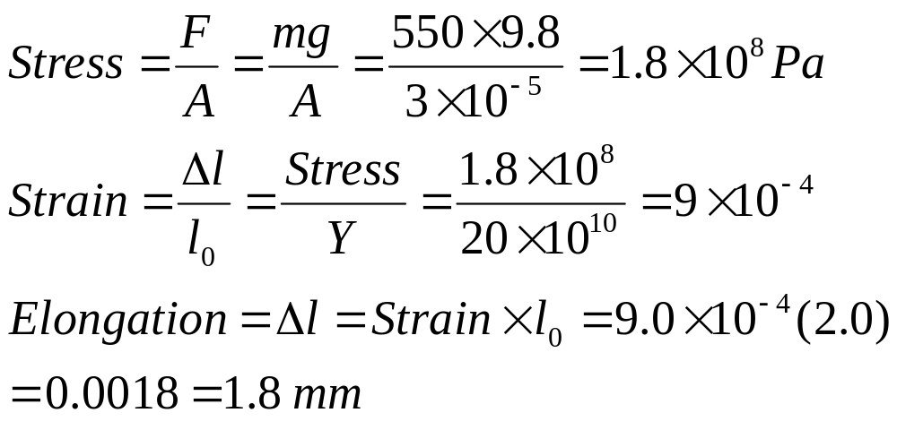
Example 11.6 Tensile stress and strain
A steel rod 2.0 m long has a cross-sectional area of 0.3 cm². The rod is now hung by one end from a support structure and a 550 kg milling machine is hung from the rod’s lower end.
Determine the stress, the strain, and the elongation of the rod. (Y for steel = 20 x 10¹⁰ Pa).

Slide 21
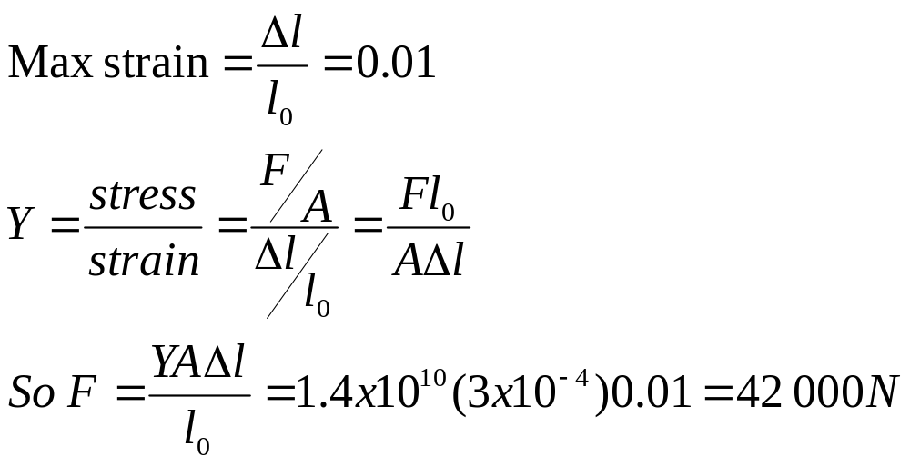
Example: Stress of bone
Young’s modulus Y for bone is about 1.4 x 10¹⁰ Pa. Bone can take about a 1.0% change in its length before fracturing. Calculate the maximum force that can be applied to a shin bone whose minimum cross-section area is 3.0 cm².
Notes:
Let’s try a few more examples

Slide 22
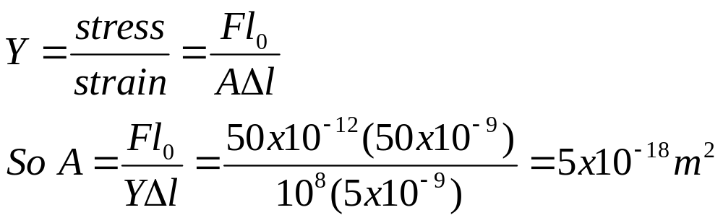
Example: Cross sectional area of DNA
A force of 50 x 10⁻¹² N is required to stretch a sample of DNA of length 50 nm and Young’s modulus Y = 1x10⁸ Nm⁻² by 10 % of its original length. Determine the cross-sectional area of the DNA molecule.

Slide 23
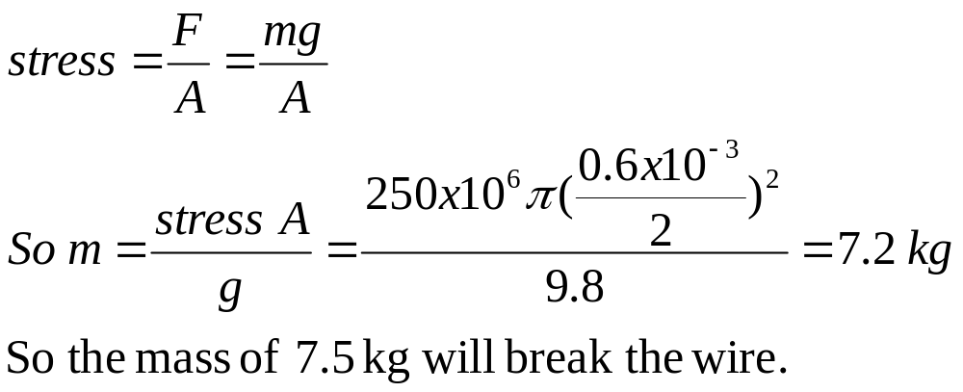
Example: Breaking stress of Copper Wire
A copper wire with diameter 0.6 mm is hung from the ceiling. Masses are added 0.5 kg at a time. If the tensile strength of copper is 250 x 10⁶ Nm⁻², calculate the value of the least mass that could be added to break the wire.

Slide 24
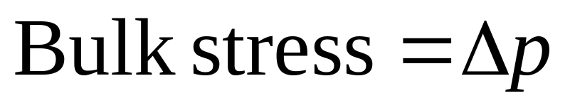
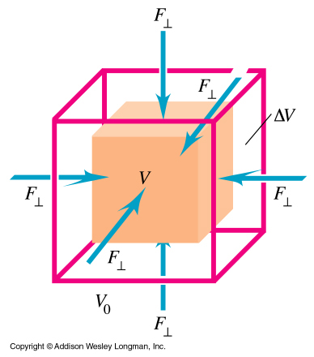
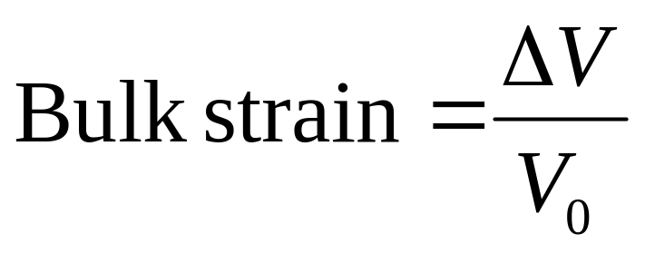
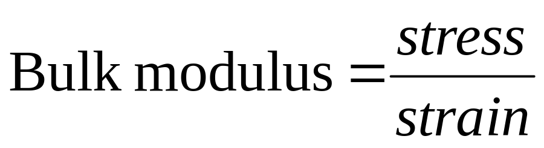
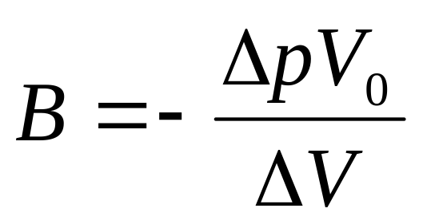
Bulk (volume) stress and strain
Notes:
Let’s look at the bulk stress and strain. How do we measure these quantities ? Well the stress is related to a force of some sort. In this case its due to a force acting uniformly over the surface. For example a submarine submerged in the water, the water exerts a force uniformly on its surface and squeezes it. So not pulling on one end as with the tensile stress. We’re sort of squeezing the object. See this in the picture….a force F acts uniformly and produces a change in volume.
The bulk strain is the change in volume per unit volume (before we had change in length per unit length). The equations are as shown.
When changes in pressure are small then the ratio of stress to strain is constant, just like for the tensile case where this constant was called Young’s modulus, or the tensile modulus.
The bulk modulus is given the symbol B. It has a negative sign as if we increase pressure, delta p goes up but delta v goes down (volume decreases) and B is a positive number.

Slide 25
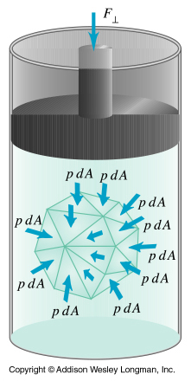
Bulk stress and strain
Air is compressible- does this give it a large or small bulk modulus?
Water is usually talked about as being incompressible (particularly when drawn into the air intake of an engine). Does this give it a large or small bulk modulus?
Relatively small
Relatively large

Slide 26
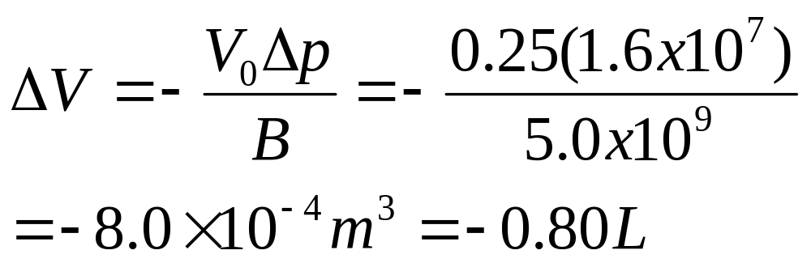
Example 11.7: Bulk stress and strain
A hydraulic press contains 0.25 m³ oil. Find the decrease in volume of the oil when it is subjected to a pressure increase Δp = 1.6x10⁷ Pa. The bulk modulus of the oil is B = 5.0x10⁹ Pa.

Slide 27
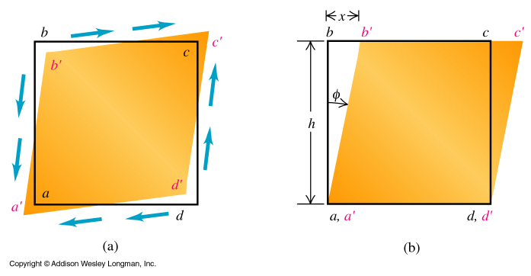
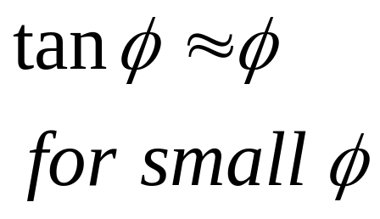
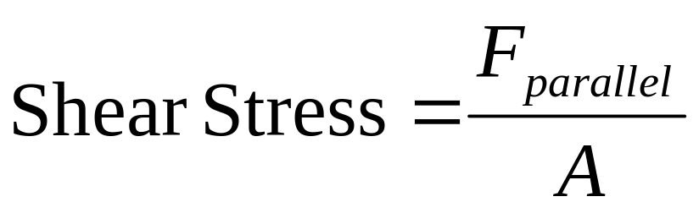
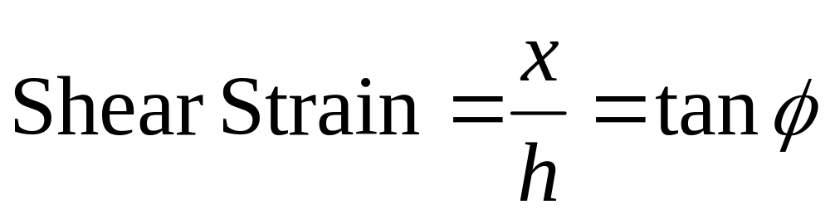
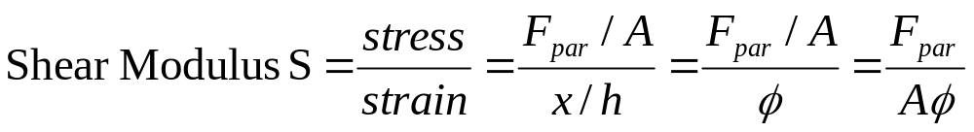
Shear stress and strain
Notes:
Now Let’s look at the shear stress and strain. How do we measure these quantities ? What’s going on in this shear case ? In this case it is a force applied at a tangent to a material, so not that perpendicular force that just changes the length of the object as for the tensile case. The diagram shows what’s going on. A force is applied parallel to a surface (take the right hand picture where bottom surface held stationary, top one has a force applied along the edge bc, parallel to it going to the right) and this distorts the objects shape. Can see that the left hand edge has been moved through an angle psi.
Lets’ start with the stress, that quantity related to the applied force. This is parallel force/area of surface over which it is applied (so bc times the depth of this object, the amount it goes back into the paper).
Shear strain is related to the amount the substance is deformed…..x/h, the ratio of the displacement x to the transverse dimension h.
When forces are small then the ratio of stress to strain is constant and in these instances tan psi = psi as angle is small.
The shear modulus S is stress over strain as shown.

Slide 28
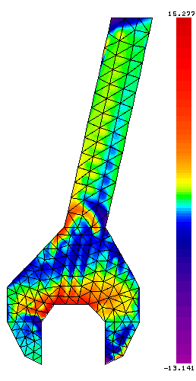
Stressed spanner
The color code gives indication of how much stress in different positions

Slide 29
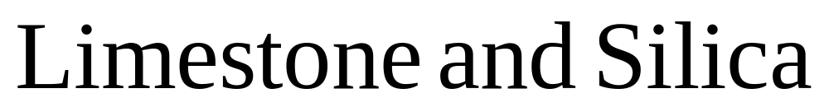
Will cement dry underwater?
What is the difference between cement and concrete?
What is cement made of?

Slide 30
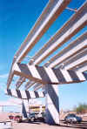
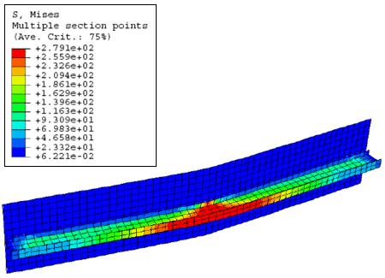
Concrete beams used in construction are “prestressed”
Notes:
Is presttressing something that happens to secretarys

Slide 31
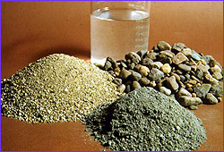
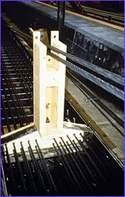
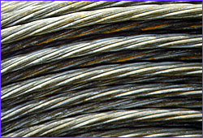
Pre-stressed
Concrete girders
Notes:
Can cement dry underwater- - a job for myth busters.
Pressetressing concrete- about 14 tons weight on each…… .cable

Slide 32
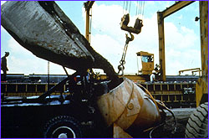
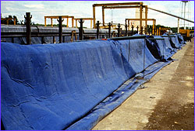
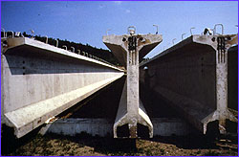
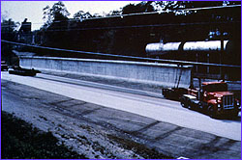
Pre-stressed Concrete girders

Slide 33
